Slide 1

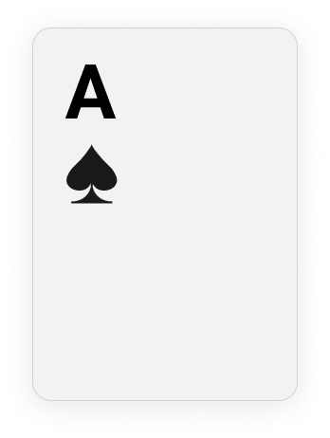
By: Heran Haile, Talha Kamran, Michelle Thevenin, Yujia Zhang

Slide 2

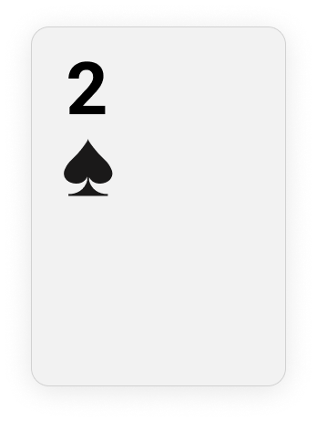
Goals
Play for fun!
Reach 21 points
Gain coins
Notes:
Michelle

Slide 3



Rules of the Game
Start with 500 coins
Choose cards to reach 21
>21 : lose half of coins
<21 : gain coins
400 for 20, 300 for 19, 200 for 18, 100 for 17
=21 : double coins
Player can choose to continue or surrender when value is 17-20
Notes:
Michelle
Goal of the game is to not exceed 21 points in card value
User sees all of cards faced down
Picks two cards, to determine initial value
User continues picking one card at a time
If value over 21 → user lost
If less than 21, user can continue choosing cards
Point System

Slide 4
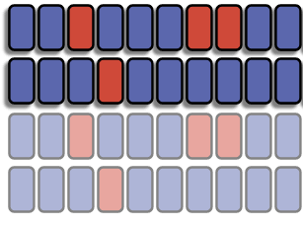

Functionality
User input
Choose cards using FPGA switches
Display output
Current card value sum shown on 7-segment display
VGA Display with cards
Card patterns: 4 colors, 10 numbers → 40 cards
ALU
Addition: total points so far
Subtraction: how far from 21? Closest gives higher scores
Virtual board on Vivado
Notes:
Michelle

Slide 5




Specifications
Present with 40 cards, choose two
Time Limit: 10 seconds
Needs a 10 sec clock
Lose coins if time runs out
Must decide whether or not to keep picking cards
Round Limit: 10
Start with 500 coins
If greater than 21…
If less than 21…
Final coin amount
Notes:
Heran
Requirements around it
Start with 500, pick two cards
Then pick another one
-if >21, lose half
-if <21, 20: gain 400, 19, gain: 300; 18 gain:200, 17: 100
-take powers (so don’t have to multiplications between decimals)

Slide 6

Input/output Flow
See 40 cards on VGA display
USER INPUT
FPGA
VGA DISPLAY
Display current sum and total coin amount on VGA display
Pick two cards and decide if continue picking the card(s)
Notes:
Cynthia:
Input → fpga → vga display
Presented with 40 cards on the vga dispaly for the user to choose from
User’s input are sent to the board, calculating the current sum as well as adding another card that the user picked
Lastly, the final coin amount will be displayed on the vga display and current sum will be shown in seven-segment display

Slide 7
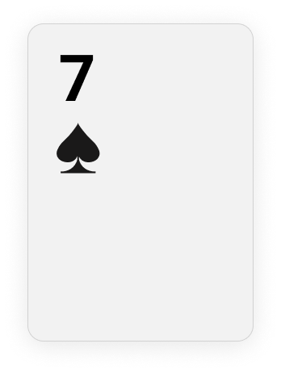
Block Diagram
Can also used to specify Card number that the user would like to pick after first two cards
Taking more cards? (1 or 0)
a5
a4
a3
a2
Current sum
Pick two cards by specifying their numbers (each card is number from 1-40)
40₁₀ = 101000₂, so 6 bits
a1
a0
Final coin amount
b5
b4
b3
b2
b1
b0
Notes:
Cynthia
The user will be presented with 40 cards. And the user has 500 coins to start with.
Facing down, meaning they don’t know what is the value of the card
1-40 are just sequence number, not the actual value of the card
The user specify two cards, for example, 21st card and 40th card; then a = 010110, b = 101000
The ALU will calculate the sum of two cards and show the current sum and final coin amount.
Because only 1-9 is possible for any card, worst case 9+9 = 18 won’t go above 21.
Next, the user will pick another card in 10 seconds. If greater than 10 seconds, then lose 10 coins
When putting in another card, set b = 000000, and use a to represent the card of interest
Calculate current sum and the final coin amount
Repeat this process for 10 times, 10 rounds

Slide 8
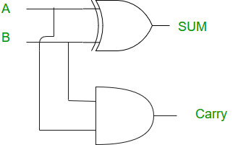
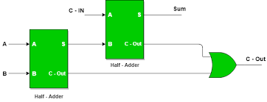
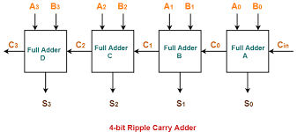

Basic Components of the ALU
Half adder to full adder
Full adder to ripple carry adder
Notes:
Cynthia
-inspired by lab3
-develop ALU from half adder, full adder, and ripple carry adder

Slide 9
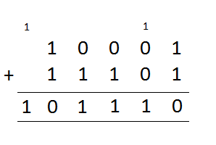

Addition
Using an adder to add the value of cards and the total amount of coins
Show current sum
Notes:
Start with last digit, then move to the left depending on result
If greater than 1, have a carry value

Slide 10
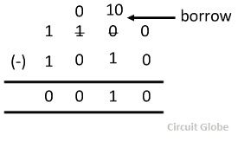
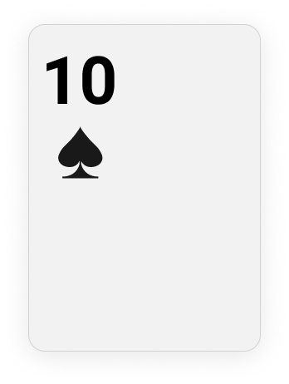
Subtraction
Using an subtractor to calculate how far the current sum is away from 21
Calculate the coin amount left after loss
Notes:
When subtracting 1 from 0, borrow 1 from next digit
Reduce digit by 1, and left with remainder
Also it is used to subtract points when you loose.

Slide 11
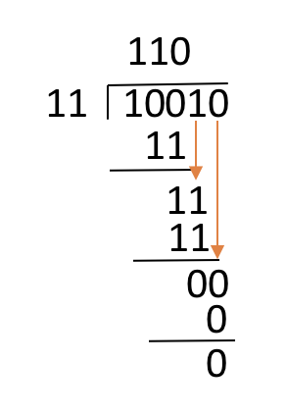
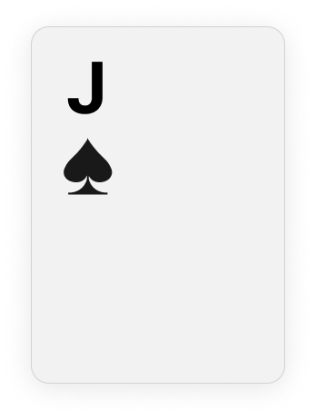
Division
Using a divider to compute the new coin value when the player loses half
Just divide current coin value by 2
Notes:
Combine shift and subtraction
Set quotient = 0
Align most significant digits in dividend and divisor
As long as dividend is greater than divisor
If the matched portion of dividend is greater than divisor
Subtract divisor from that portion
Concatenate 1 to the right hand end of the quotient
Else concatenate 0
Shift the divisor one bit right to find the next alignment

Slide 12


Clock divider
Use FPGA system clock to create a 1 second clock using clock divider
Then mimic the passage of 10 seconds
Notes:
Use clock divider
If 10 second clock is exceeded then you lose 10 points

Slide 13
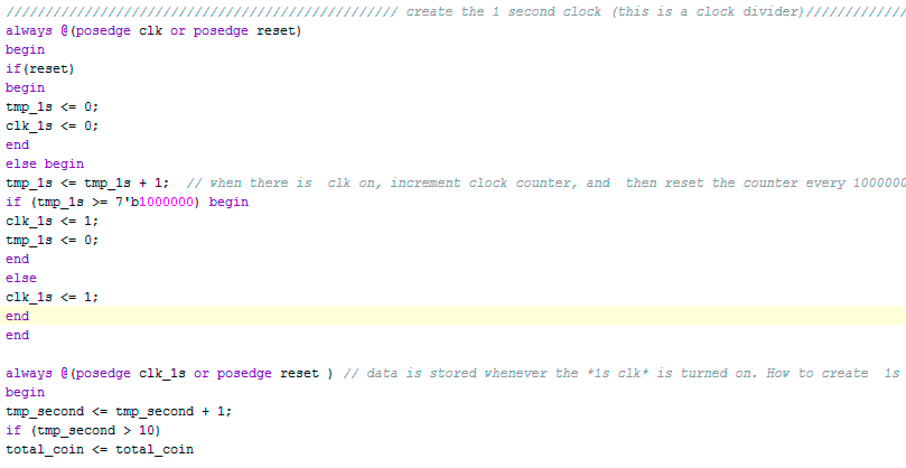

Code Snippet
Clock divider
Notes:
Screen shot of part of code here
Maybe the display portion?
FPGA has a 1 megahertz clock and we will increment the actual counter by 1 for every 100000 positive edges to mimic the passage of one second
Then use this 1second clock to calculate how many actual seconds have passed
And then do something about the total coin amount

Slide 14

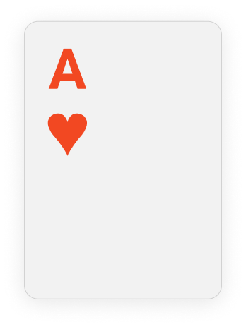
Successes!
Game Rules
Displaying All the Cards
Coin System
Multiple rounds
Round Limit
Time limit
Notes:
Heran
Display 1 -40 cards
4 diff colors
1- 10
Can go unlimited rounds
Time limit, so the user can’t spend whole time on it

Slide 15

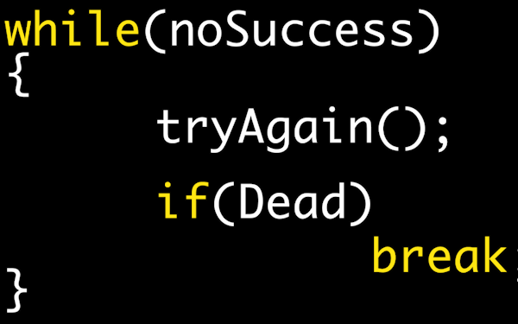
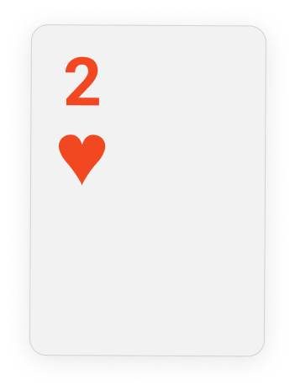
Failures
Points based on percentage
Wanted to make 2-player or utilize a “dealer”
Not randomized
Want to represent in space, but instead name them 1 - 40
Notes:
Heran
Main thing is time limit
Things that could have been done differently
(can also mention not done because of time)
The cards have a set spot, so theoretically the user can memorize the spots if where the cards are

Slide 16


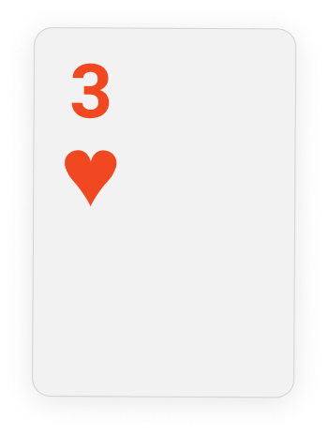
Thanks for listening!

